Slide 1
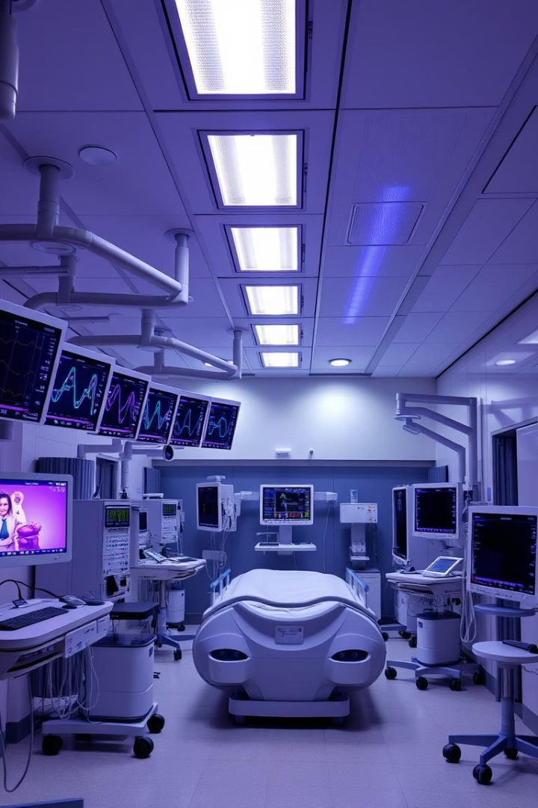
ICU System Design: Measurments Final Project
Presented by Dr. Nevin Saleh and Eng. Rahma Saad.
This project designs a responsive ICU System ensuring patient safety.

Slide 2

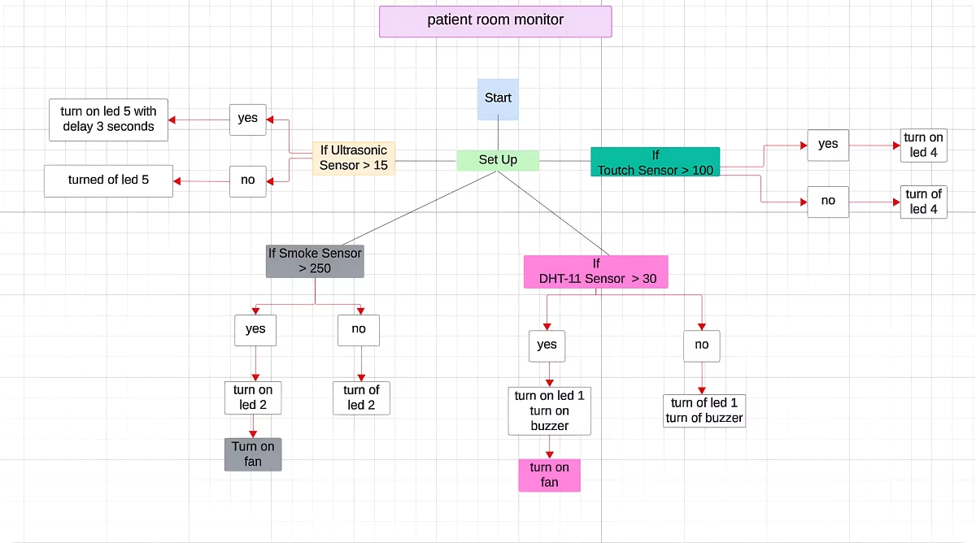
System Flow Chart Overview
The flow chart illustrates data paths between sensors, controller, and actuators.
It supports real-time monitoring and responsive control in the ICU environment.
Input Sensors
Temperature, humidity, smoke, patient touch signals.
Microcontroller (Arduino)
Processes sensor data and triggers actuator responses.
Output Devices
Fans, alarms, LCD display, LEDs for feedback and alerts.

Slide 3
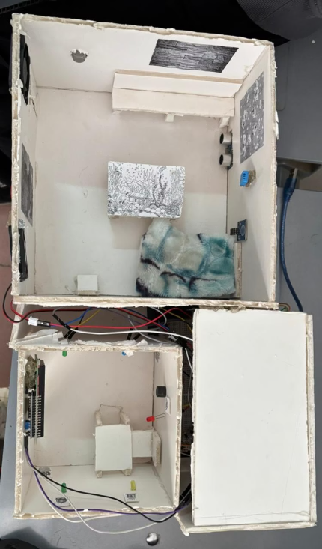
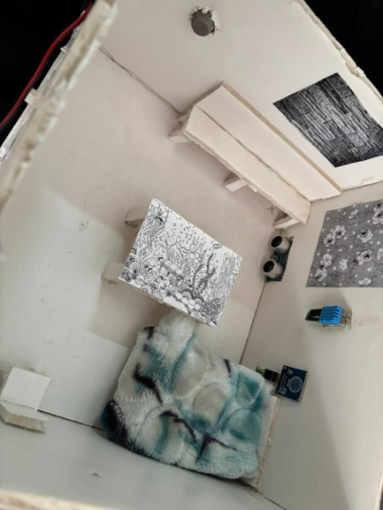
ICU and Control Room Visuals
Room with Arduino and interfaces managing the ICU system.
ICU room setup showing sensor integration and patient environment.

Slide 4
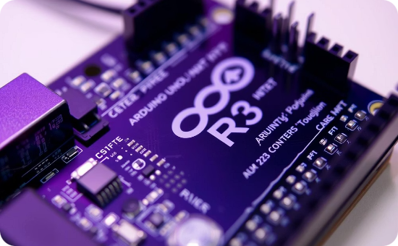
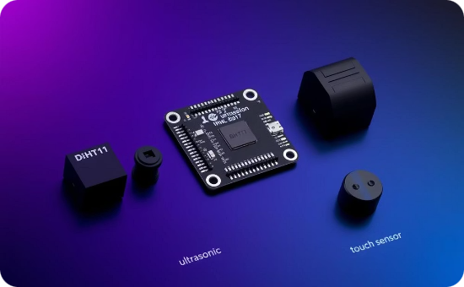
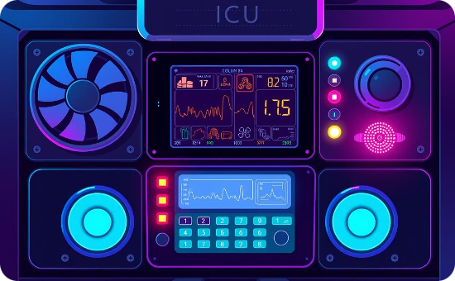
Key System Components
Microcontroller
Sensors
Actuators
Arduino Uno R3, central processor managing all sensor and actuator controls.
Temperature, humidity, smoke, distance, and touch sensors provide environment data.
Fans control ventilation, LCD displays feedback, LEDs and buzzers alert staff.

Slide 5
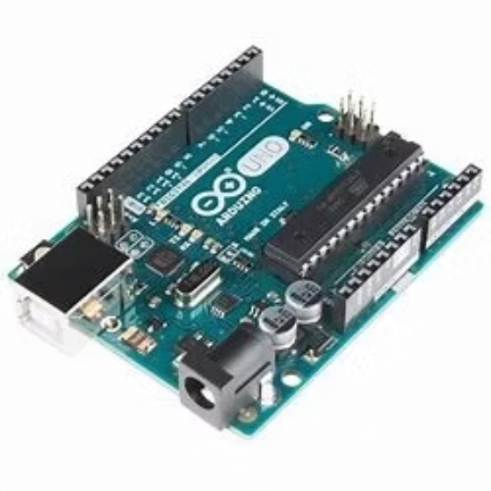
Arduino Uno R3: System's Control Center
The Arduino processes sensor inputs, executes logic, and controls devices.
Programming via Arduino IDE makes coding accessible.
Triggers actuators such as fans, buzzers, and LEDs.
Ensures timely system response to environmental changes.

Slide 6
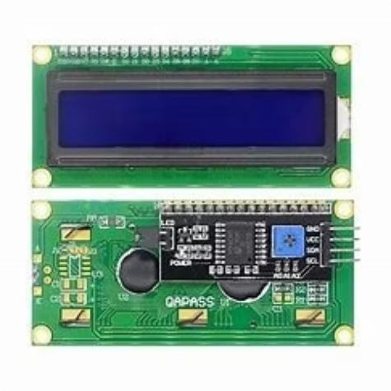
LCD Display: Real-Time System Feedback
Displays sensor data for monitoring temperature, humidity, and smoke.
Shows alerts when abnormal conditions are detected by sensors.
Indicates patient assistance requests from touch sensor activation.
Provides continuous feedback supporting staff decisions.

Slide 7

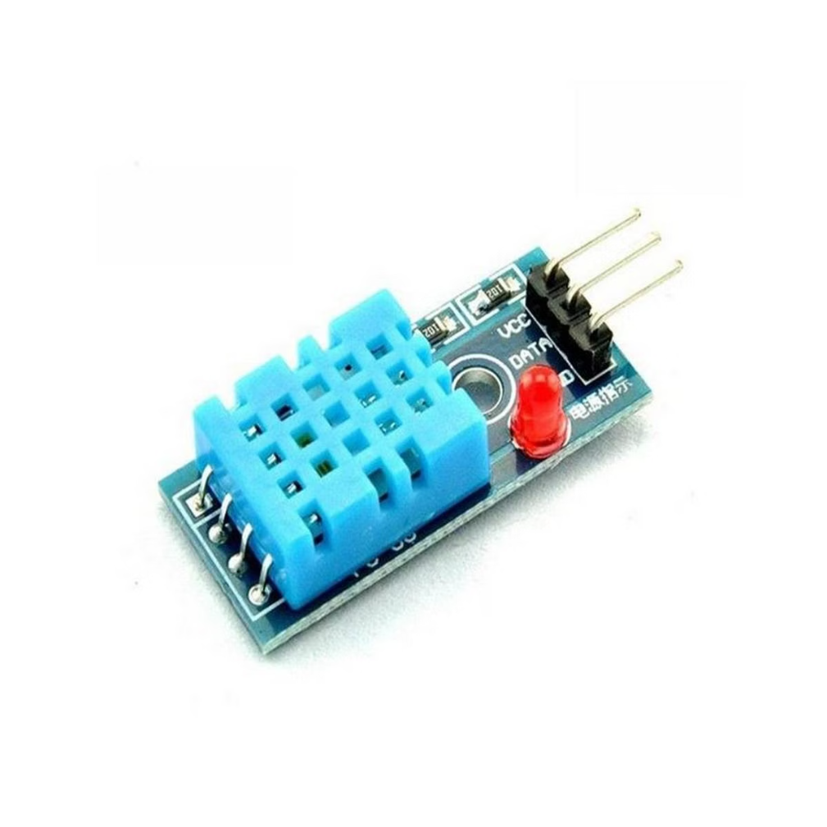



DHT11 Sensor: Temperature and Humidity Monitoring
Temperature Sensing
Continuously measures room temperature, alerts on thresholds.
Humidity Monitoring
Keeps track of humidity; activates fans to maintain optimal air quality.
Alert Triggering
Signals Arduino to activate alarms and fans when limits are exceeded.

Slide 8
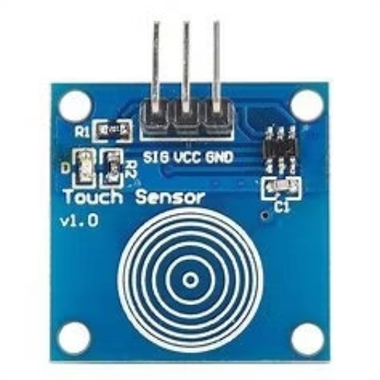
Touch Sensor: Patient Assistance Activation
Patients activate the touch sensor to request immediate help.
The system responds instantly with visual and audible notifications.

Slide 9
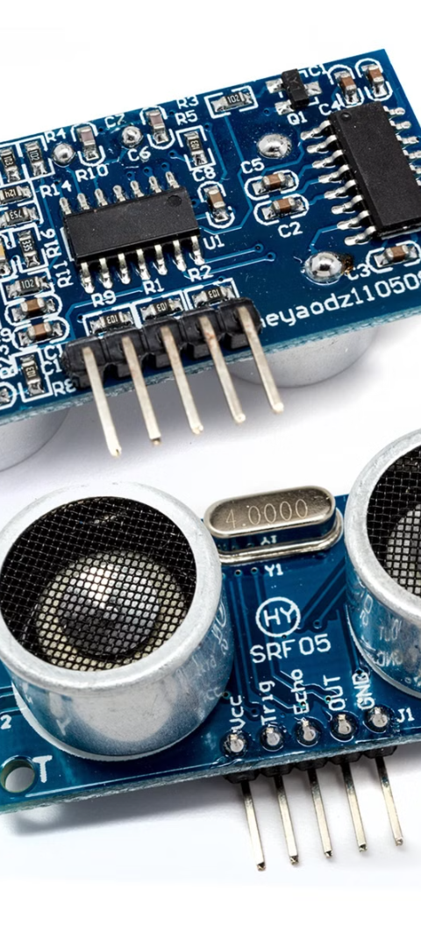
Ultrasonic Sensor: Distance Measurement and Security
Distance Measurement
Door Monitoring
Measures proximity to objects or persons within ICU room.
Detects entry or door open status to alert staff.
Alert Generation
Triggers LCD and LED alerts when distance thresholds are crossed.

Slide 10

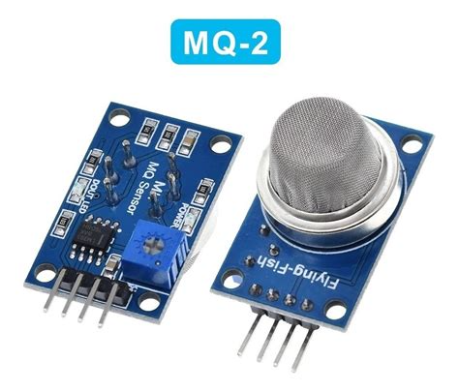
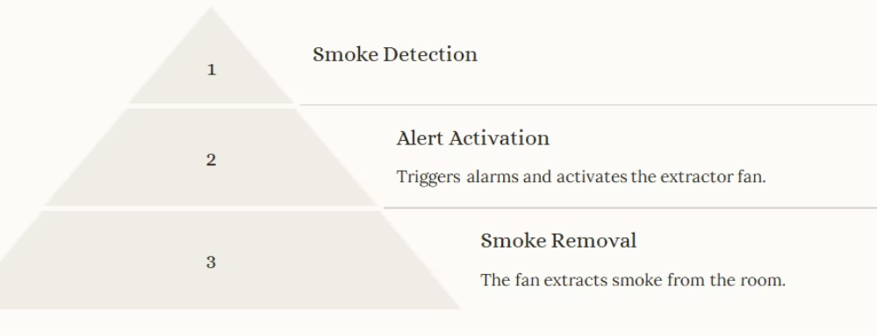
MQ-2 Sensor: Smoke Detection and Response

Slide 11
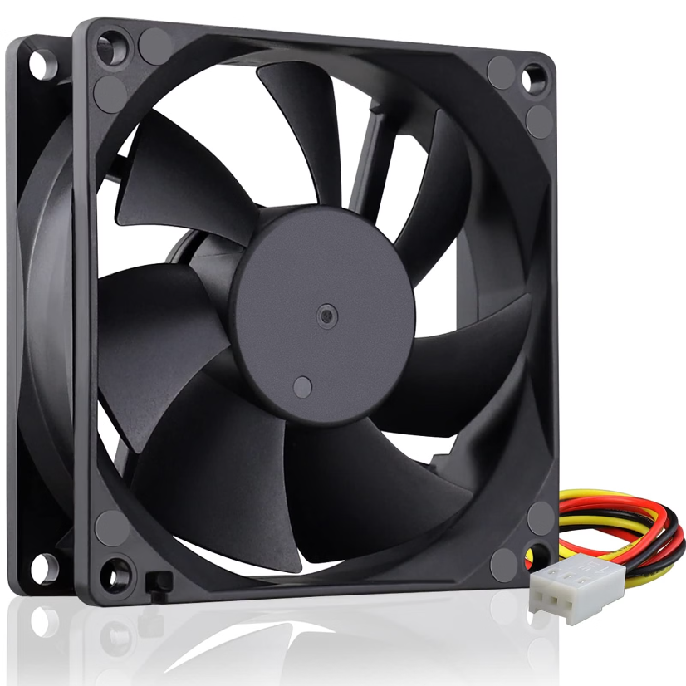
Fans: Ventilation and Extraction
Temperature Control
One fan is used to regulate temperature in the ICU room
2. Smoke Extraction
The second fan serves as an extractor fan to remove smoke.

Slide 12
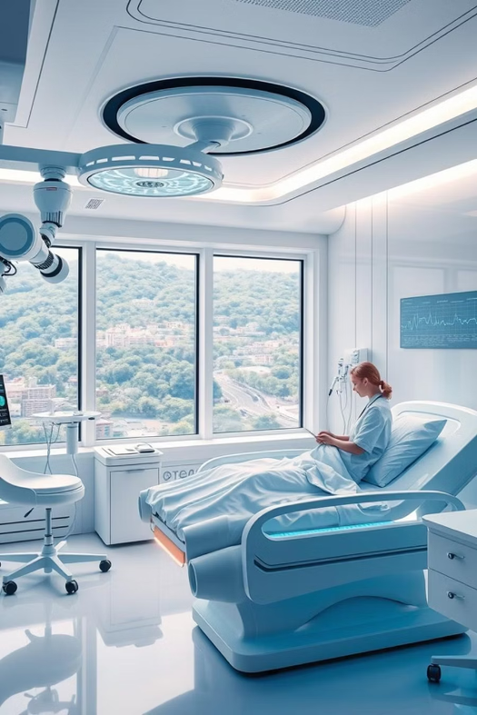
Conclusion: A Step Towards Safer and More Efficient Care
This smart ICU system represents a significant step towards improving patient safety and healthcare efficiency. Its sensor-based monitoring system and automated response mechanisms offer a crucial layer of protection, facilitating prompt intervention and enhancing overall patient care.

